Slide 1
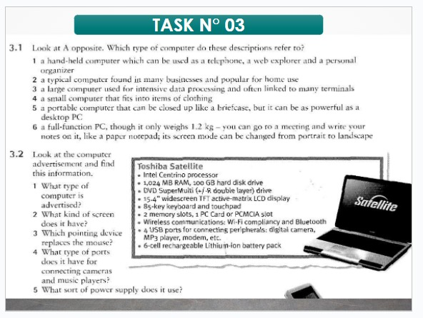
3.1 TASK N° 03 Look at A opposite. Which type of computer do these descriptions refer to?
1 a hand-held computer which can be used as a telephone, a web explorer and a personal organizer (Personal Digital Assistant or PDA)
2 a typical computer found in many businesses and popular for home use. (Desktop PC)
3 a large computer used for intensive data processing and often linked to many terminals (Mainframe)
4 a small computer that fits into items of clothing. (Wearable computer)
5 a portable computer that can be closed up like a briefcase, but it can be as powerful as a desktop PC (Laptop)
6 a full-function PC, though it only weighs 1.2 kg-you can go to a meeting and write your notes on it, like a paper notepad; its screen mode can be changed from portrait to landscape (Table PC)

Slide 2
3.2 Look at the computer advertisement and find this information
What type of computer is advertised?
A Toshiba Satellite computer is advertised.
2. What kind of screen does it have?
It has a 15.4" widescreen TFT active matrix LCD display.
3. Which pointing device replaces the mouse?
The touchpad replaces the mouse
4. What type of ports does it have for connecting cameras and music players?
It has 4 USB ports for connecting cameras, MP3 players, modems, etc.
5 What sort of power supply does it use?
It uses a 6-cell rechargeable Lithium-ion battery pack as the power supply.
Renzo Neyra Quesquén

